Slide 1
Chess With Min Max Algorithm
Fardin Mohammed, Filip Matracki, Ivan Matyazh

Slide 2
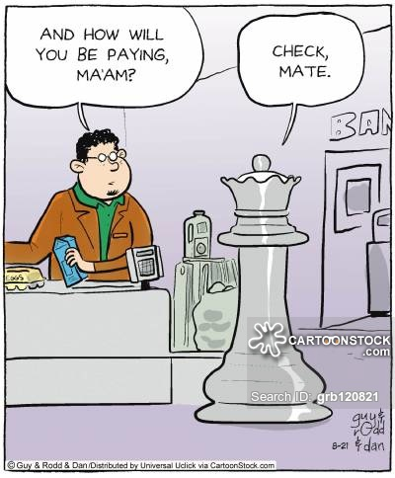
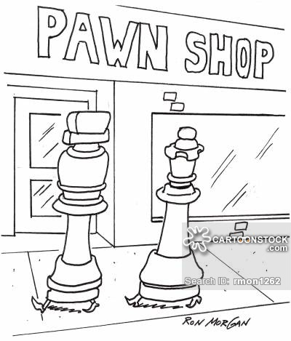
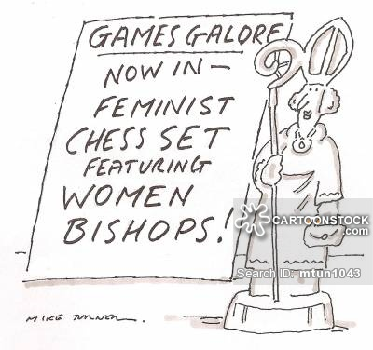
Some Funny Jokes

Slide 3
A Short Introduction
A WPF(Windows Presentation Foundation) application implemented in C#.
The application is used to play chess with Min-Max algorithm AI bot.
The application is used to test the boundaries of Min-Max algorithm in different depths.
The application has two game modes:
Human vs Human
Human vs AI (Artificial Intelligence)

Slide 4
Mechanism
Min-Max algorithm is used to determine score in a zero sum game.
We use Min-Max to maximize the score of one side without knowing about the other side’s moves but by evaluating its current possibilities.
We use an evaluation function to find the score for the current state of each side and try to maximize for one side.

Slide 5
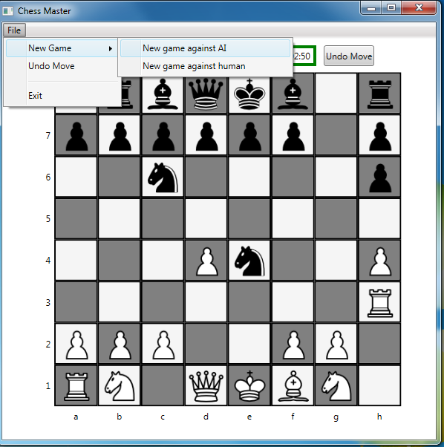
Setup the game

Slide 6
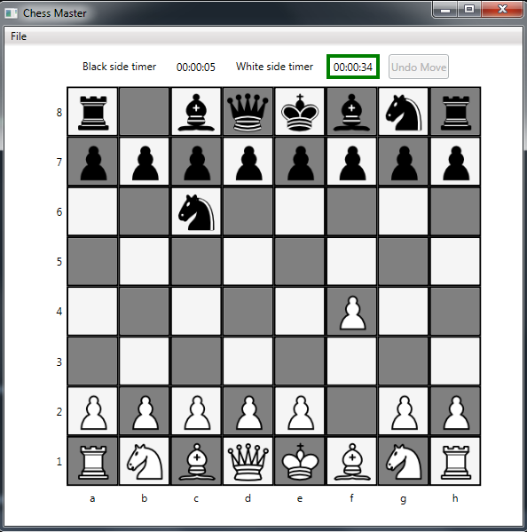
Moves In Progress

Slide 7
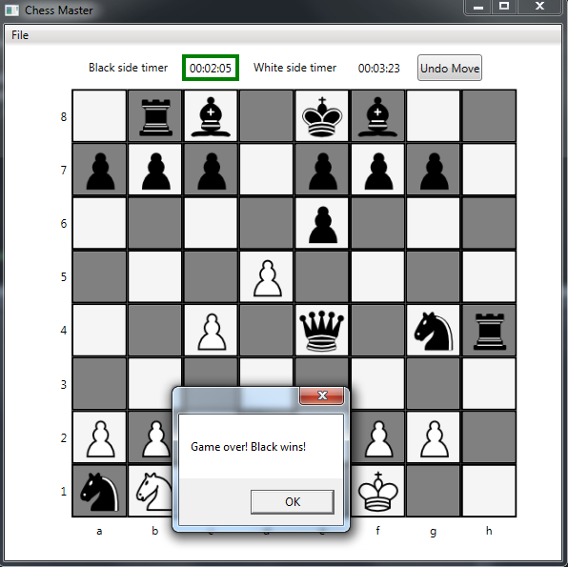
AI wins

